Slide 1
Database Management(DBAS32100)

Slide 2
SQL Procedural Exension
Static SQL
Walid Belal

Slide 3
STATIC SQL
Static SQL statements are the statements that can be used directly directly inside PL/SQL block
SELECT INTO
INSERT
UPDATE
DELETE
MERGE

Slide 4
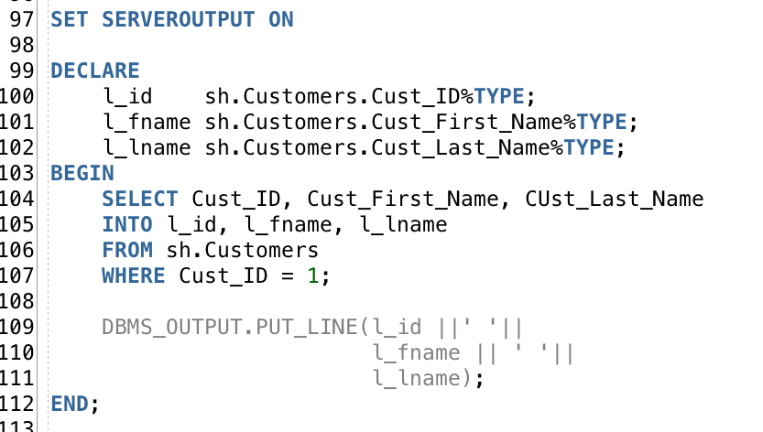
SELECT
Here you declare variables that have the same data type as columns in customers table
You need to select into a variable(s). A variable holds only one value so your select statement needs to return only one value per variable

Slide 5
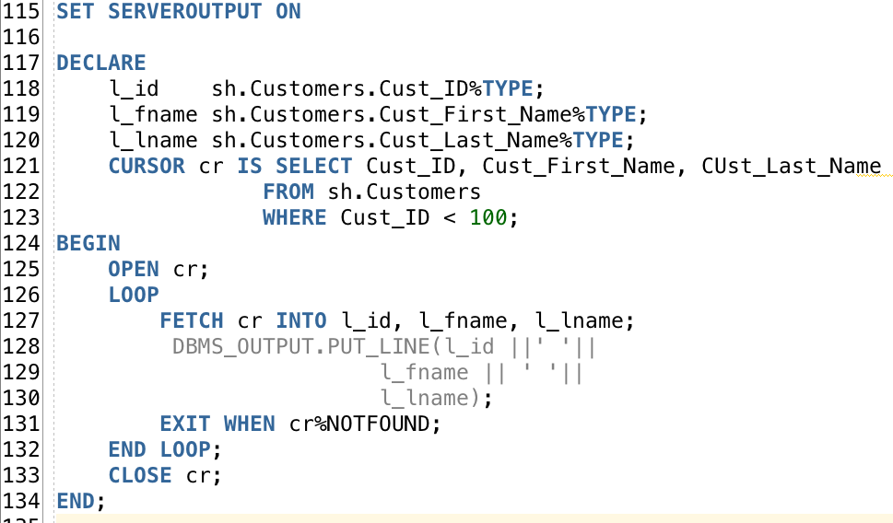
Access Selected rows using cursors
Cursor is a pointer to a data structure that holds the result set of a select statement and allows accessing this result on a row by row basis
Open the cursor and loop through the selected rows
Here you are fetching a row from the selected set into variables

Slide 6
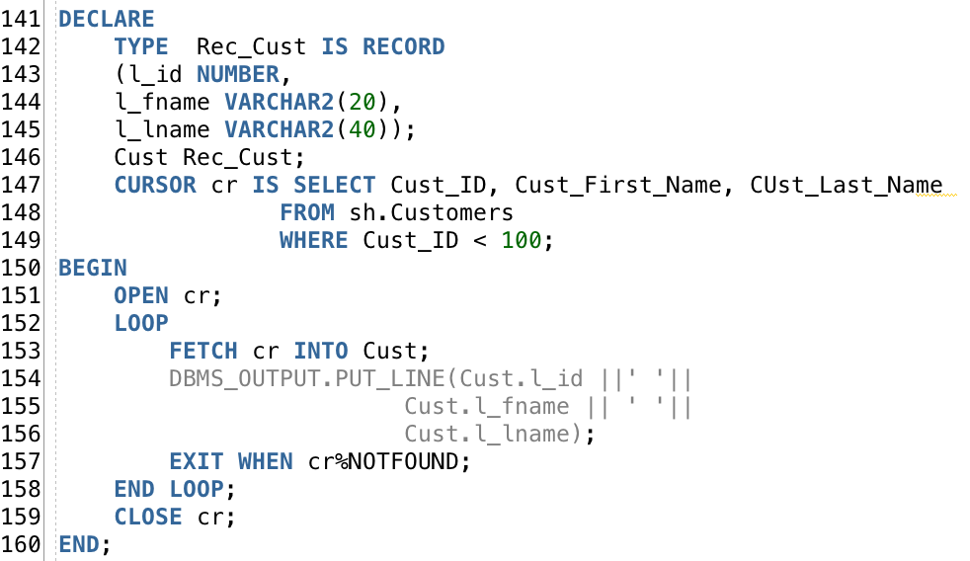
USE records to hold selected rows
Record is a data structure that can have fields with different data type. You can think of it as a row of data
You can use variables of record type to hold a complete row of the selected set

Slide 7
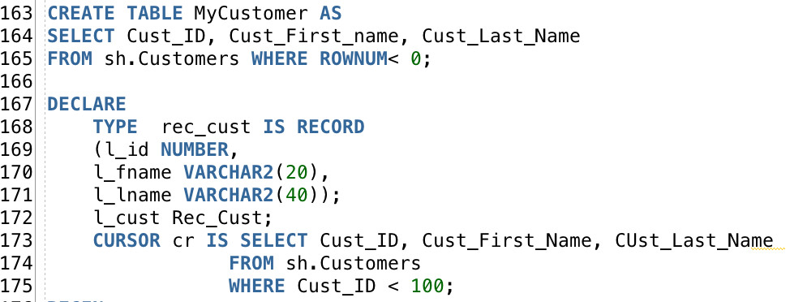
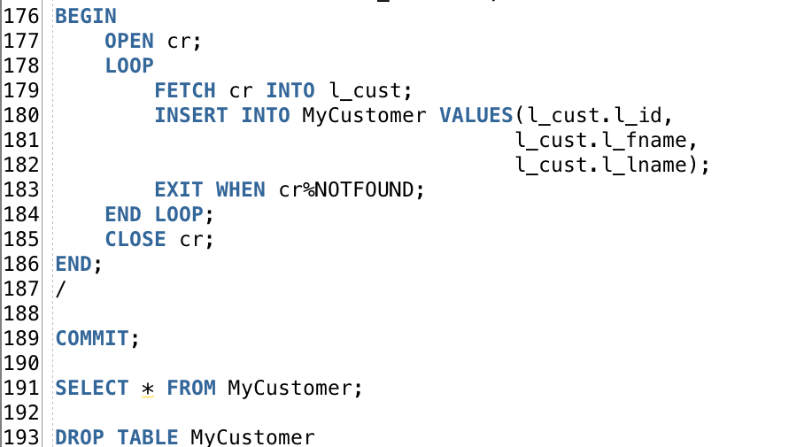
INSERT
This statement create a table based on the result of the select statement. This will be the table where will you insert data
Here you are inserting row by row so the insert statement is implemented 100 times. this is not efficient so in few slides you will learn how to make bulk inserts
Don’t forget to drop the table

Slide 8
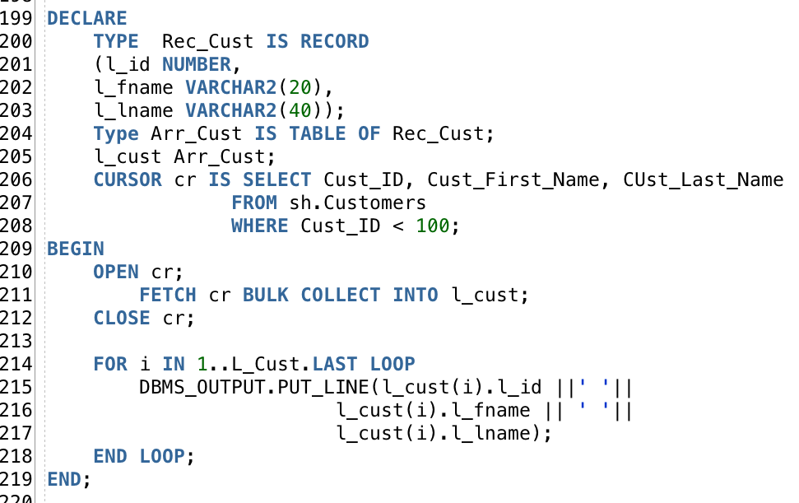
You can us bulk operators collect all the rows at once into a data structure in your program. It is much faster if you have a lot of rows as the PL/SQL engine does not make many context switches to the SQL engine
BULK COLLECT ROWS
Here you made a custom collection (like an array) type. It is a collection that holds data of type record. So you can say it is a collection of records. If one record can hold a row in a selection set then a collection of records can hold the whole selection set
You are fetching the whole selection set into the collection of records. You do not need to llop as you do not need access to individual rows
Now all your data is inside the collection of record. You can loop through it and have full access to the data

Slide 9

Useful tips
You can define a variable that has the exact same data type as a column in a table
You can define a record to have the exact same structure as a table then you can reference the record type to the table.
Average_Amount_Sold is a variable of the same type as Amount_sold column
Cust is a variable of a record type that looks exactly like sh.Customers table

Slide 10
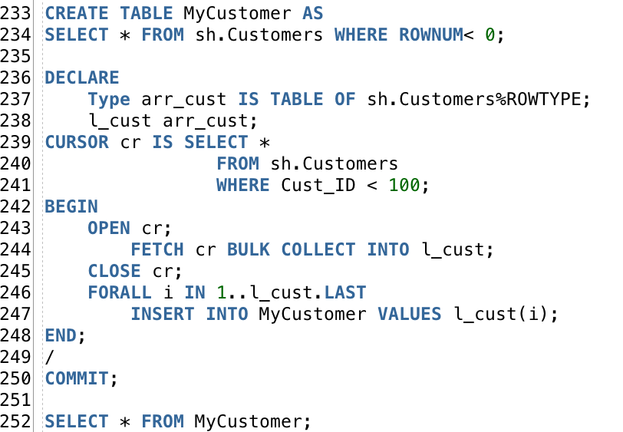
Bulk insert is more efficient operation that will preent context switches
BULK INSERT
FORALL Statement is used is used to make bulk DML. You can only include one DML (INSERT, UPDATE, DELETE) in FORALL statement

Slide 11
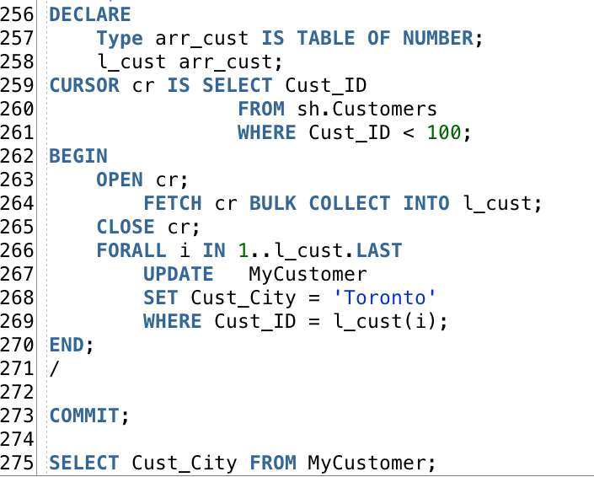
BULK Update
Here you fetched all the customer ids that are < 100 into an array
Here you used these ids as a condition of updating the cities. In other words you updated the city of the customers whose id is in the array

Slide 12
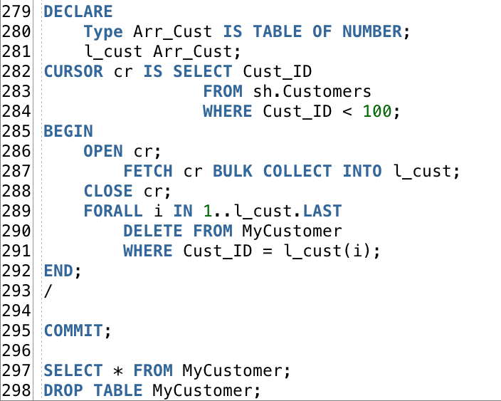
BULK Delete
Here you deleted all the customers whose ID is in the array of selected ids
You don’t need this table anymore. Don’t forget to drop it

Slide 13
A
Practice
20 Minutes
Develop a PPL/SQL Block that Extract all the data from PCustomer table and load it to PCustomerEast table if the customer city is Montreal and PCustomerWest if the customer city is Vancouver.
Below is the data dictionary and sample data for PCustomer Table
Below is the dictionary for PCustomerEast and PCustomerWest (they are identical)
Column Name | Data type | Sample data (this is how data
CustID | NUMBER | 1
CustFirstName | VARCHAR2(12) | Roger
CustLastName | VARCHAR2(12) | Waters
CustCity | VARCHAR2(18) | Toronto
Column Name | Data type | Sample data (this is how data
CustID | VARCHAR2(12) | Cu-1
CustName | VARCHAR2(24) | Roger Waters
CustCity | VARCHAR2(18) | Toronto

